Slide 1

Escalation straight-up: ESCALATION MANAGEMENT MODULE
Alabado, Matthew Arnold
Alconcel, Alanis Watz
Balubal, Samantha Nicole
Brillantes, Rachel Anne
Burton, Kathrine Danielle
Pamittan, Engel-Jan
Notes:
REMEMBER: introduce one by one

Slide 2

Overview
Introduction
Objectives
Scope and Limitations
Related Systems
Proposed System
Demo of Prototype
Notes:
In this presentation, we will be discussing the following:

Slide 3
INTRODUCTION
Client: Taal Vista Hotel
Problems:
Unattended service requests
Limited escalation process
Solutions:
Escalation process
Escalation reports
Notes:
So for our client, it is Taal Vista and they are currently facing these problems:
There are unattended service request, and
Limited escalation process which mean that they are only limited to manual process of recording history of complaints.
So we proposed a solution to make an Escalation Module
*Introduce next presenter*

Slide 4
General OBJECTIVES
Develop a solution for Taal Vista Hotel that will produce effective Escalation Reports

Slide 5
Specific OBJECTIVES
Develop an Escalation Management Module
Gather escalation data
Formulate a forecast from Escalation Reports
Decrease the number of escalation
Notes:
In order for us to meet our general objective, we need to have our specific objective which is to: …
*intro next speaker*

Slide 6
SCOPE
Process begins once a trigger is activated by an escalated service ticket from the Service Request and Report System
Generate escalation reports based on the escalation process of unattended services
Target Users:
Level 1 – Supervisor
Level 2 – Department Manager
Level 3 – Resident Manager
Level 4 – Department Manager
Notes:
Explain:
initial process
Escalation reports based on the escalation process
Levels of management (Users)

Slide 7
LIMITATIONS
Focuses on the re-assignment of tasks
Limited within the quality aspect of services
When the action needed on the service-related requests must be done by the expertise of a third party
Notes:
Clarify our scope and emphasize on the focus of our module

Slide 8
Related Systems
System Name | Common Features | Unique Features
KNOWCROSS (Know Glitch) | Real-Time Communication | Hotel Management Software
HotelTap | Real-Time Communication | Analytic Dashboard Mobile notification for instant communication among employees
FCS Computer Systems (Guest Services) | Mobile-Enabled Task escalation | Smart Escalation
ALICE (STAFF) | Mobile-Enabled Ticketing System Task-Tracking System | Accessible to-do-list through mobile Assignment of tickets Displays ticket status and owner Simple User Interface
Notes:
1st Half: Engel

Slide 9
Related systems
System Name | Common Features | Unique Features
Guest Experience Software System (GESS) | Task Escalation | Automatic Alert that notifies the employees
HotelMGR | Mobile-Enabled Task-Tracking System | Request Prioritization
Oracle Escalation Management | Task-Tracking System | Ownership assignment De-escalation and closure Automatic notification (escalation progress)
Escalation Straight-Up | Mobile-Enabled Task escalation Assignment of tickets | Notification alert Hierarchy level of senior employees for escalation process of unattended service tickets
Notes:
2nd Half: Chel

Slide 10
Proposed system
Systems Overview
Use Case
Context Flow Diagram
Entity Relationship Diagram
Notes:
Explain the order of diagrams that will be discussed.

Slide 11
Systems overview
Receive: Unattended service tickets
Hierarchy Level:
Level 1 – Supervisor (SP)
Level 2 – Department Manager (DM)
Level 3 – Resident Manager (RM)
Level 4 – General Manager (GM)
Notes:
Clarify that we do not make tickets, it is forwarded to our module from the service request module

Slide 12
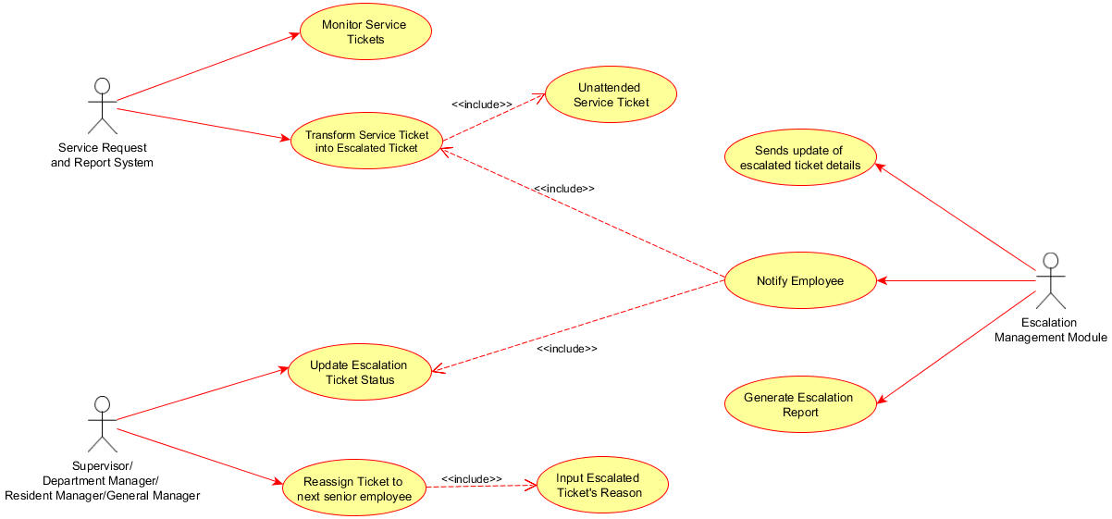
Use case

Slide 13
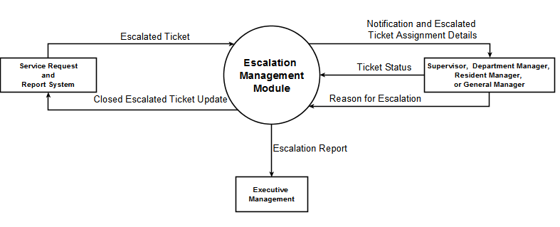
Context flow diagram

Slide 14
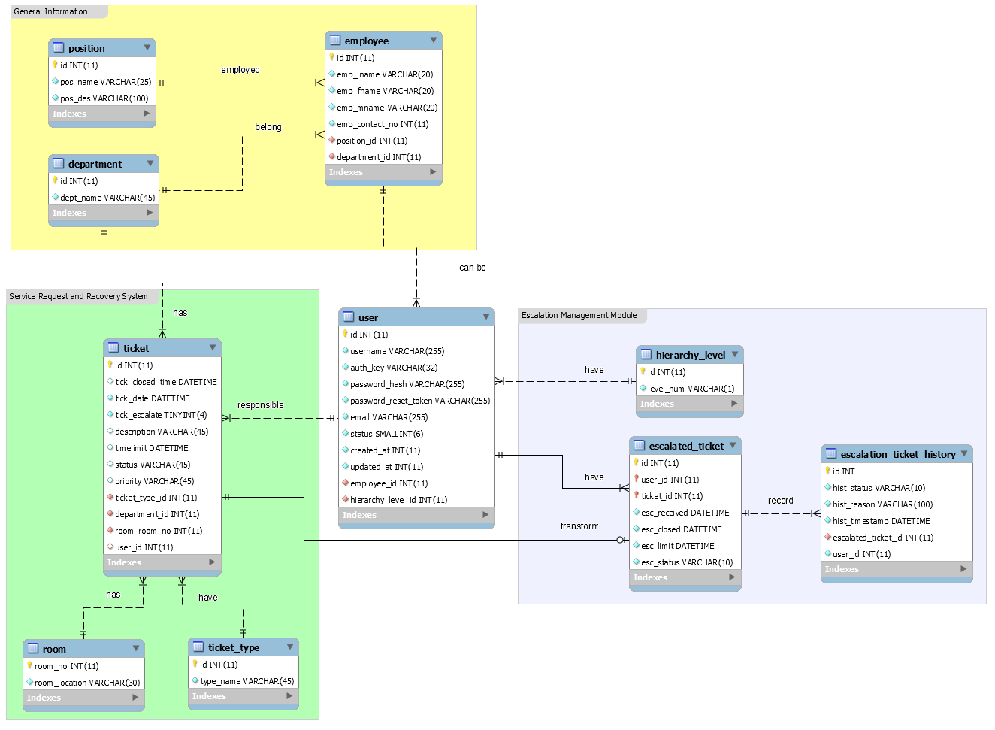
Entity relationship diagram

